Slide 1
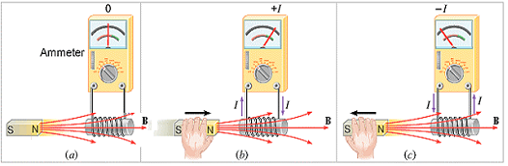
Induced Emf and Induced Current
When there is no relative motion between the coil of wire and the bar magnet, there is no current in the coil.
A current is created in the coil when the magnet moves toward the coil.
A current also exists when the magnet moves away from the coil, but the direction of the current is opposite to that in ( b).

Slide 2
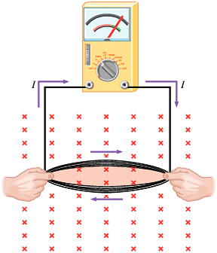
Inducing Current With a Coil in a Magnetic Field

Slide 3
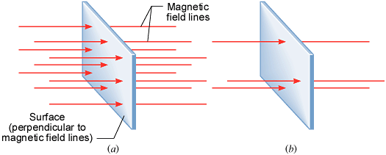
Magnetic Flux
Graphical Interpretation of Magnetic Flux
The magnetic flux is proportional to the number of magnetic flux lines passing through the area.

Slide 4
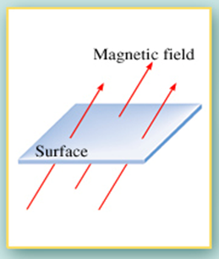
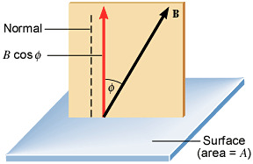
A General Expression for Magnetic Flux
The SI unit of magnetic flux is the weber (Wb), named after the German Physicist W.E. Weber (1804-1891). 1 Wb = 1 T.m².

Slide 5
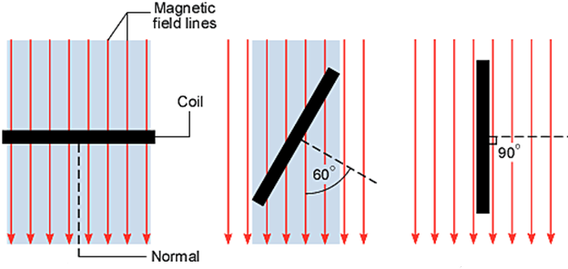
EXAMPLE on Magnetic Flux
A rectangular coil of wire is situated in a constant magnetic field whose magnitude is 0.50 T. The coil has an area of 2.0 m². Determine the magnetic flux for the three orientations, shown below.

Slide 6
Faraday's Law of Electromagnetic Induction
Michael Faraday found experimentally that the magnitude of the induced emf is proportional to the rate at which the magnetic flux changed. Faraday’s law can be written as,
where N is the number of turns in the loops, A is the area of one loop, ξ is the induced emf, and B┴ is the perpendicular component of the magnetic field.

Slide 7
Lenz's Law
The SI unit for the induced emf is the volt, V. The minus sign in the above Faraday’s law of induction is due to the fact that the induced emf will always oppose the change. It is also known as the Lenz’s law and it is stated as follows,
The current from the induced emf will produce a magnetic field, which will always oppose the original change in the magnetic flux.

Slide 8
Determining the Polarity of the Induced Emf
1.Determine whether the magnetic flux that penetrates a coil is increasing or decreasing.
2.Find what the direction of the induced magnetic field must be so that it can oppose the change in flux by adding to or subtracting from the original field.
3.Having found the direction of the induced magnetic field, use RHR-2 (see Section 21.7) to determine the direction of the induced current. Then the polarity of the induced emf can be assigned because conventional current is directed out of the positive terminal, through the external circuit, and into the negative terminal.

Slide 9
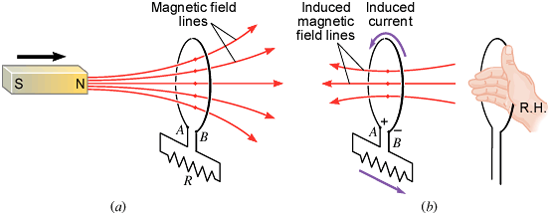
Application of Lenz’s Law

Slide 10
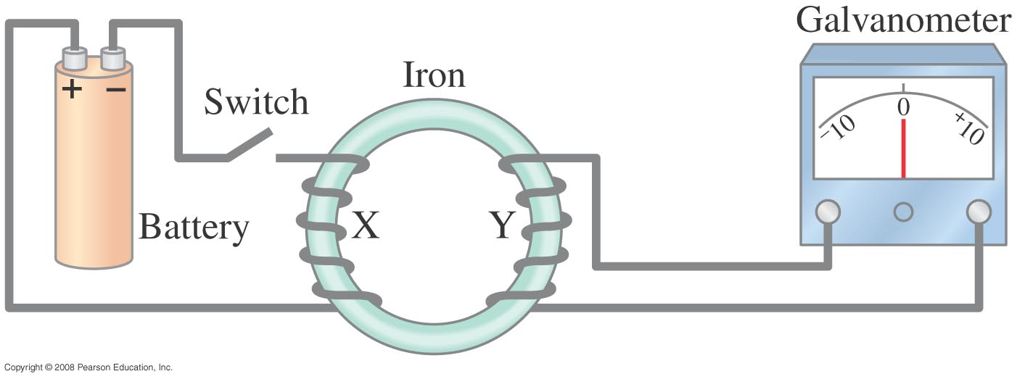
Induced EMF
Almost 200 years ago, Faraday looked for evidence that a magnetic field would induce an electric current with this apparatus:
Notes:
Figure 29-1. Faraday’s experiment to induce an emf.

Slide 11
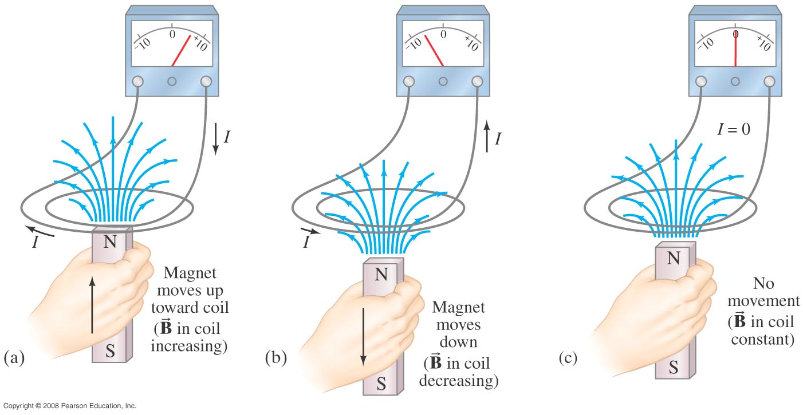
Induced EMF
He found no evidence when the current was steady, but did see a current induced when the switch was turned on or off.
Notes:
Figure 29-2. (a) A current is induced when a magnet is moved toward a coil, momentarily increasing the magnetic field through the coil. (b) The induced current is opposite when the magnet is moved away from the coil ( decreases). Note that the galvanometer zero is at the center of the scale and the needle deflects left or right, depending on the direction of the current. In (c), no current is induced if the magnet does not move relative to the coil. It is the relative motion that counts here: the magnet can be held steady and the coil moved, which also induces an emf.

Slide 12
Induced EMF
Therefore, a changing magnetic field induces an emf.
Faraday’s experiment used a magnetic field that was changing because the current producing it was changing; the previous graphic shows a magnetic field that is changing because the magnet is moving.

Slide 13
Example: move a magnet towards a coil of wire.
N=5 turns A=0.002 m²
N
S
I
v
+
-

Slide 14
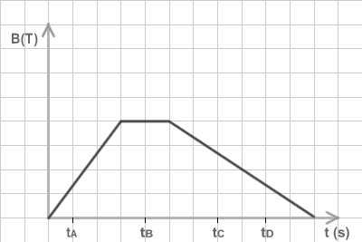
Example: a uniform (but time-varying) magnetic field passes through a circular coil whose normal is parallel to the magnetic field. The coil’s area is 10⁻² m² and it has a resistance of 1 mΩ. B varies with time as shown in the graph. Plot the current in the coil as a function of time.
.01 T
For 0 < t < 3:
=1 s
For 3 < t < 5:

Slide 15
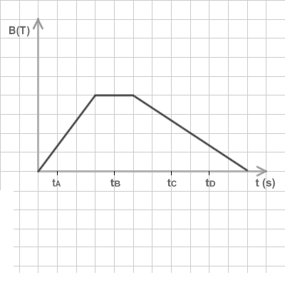
Example: a uniform (but time-varying) magnetic field passes through a circular coil whose normal is parallel to the magnetic field. The coil’s area is 10⁻² m² and it has a resistance of 1 mΩ. B varies with time as shown in the graph. Plot the current in the coil as a function of time.
For 5 < t < 11:
I(t)
.01 T
=1 s
-.0333 A

Slide 16
Experimentally…
Lenz’s law—An induced emf always gives rise to a current whose magnetic field opposes the change in flux.*
N
S
I
v
+
-
If Lenz’s law were not true—if there were a + sign in Faraday’s law—then a changing magnetic field would produce a current, which would further increase the magnetic field, further increasing the current, making the magnetic field still bigger…
*Think of the current resulting from the induced emf as “trying” to maintain the status quo—to prevent change.

Slide 17
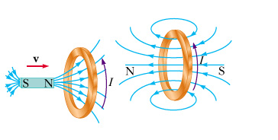
Minus Sign? Lenz’s Law
Induced EMF is in direction that opposes the change in flux that caused it

Slide 18
Faraday’s Law of Induction; Lenz’s Law
The minus sign gives the direction of the induced emf:
A current produced by an induced emf moves in a direction so that the magnetic field it produces tends to restore the changed field.
or:
An induced emf is always in a direction that opposes the original change in flux that caused it.

Slide 19
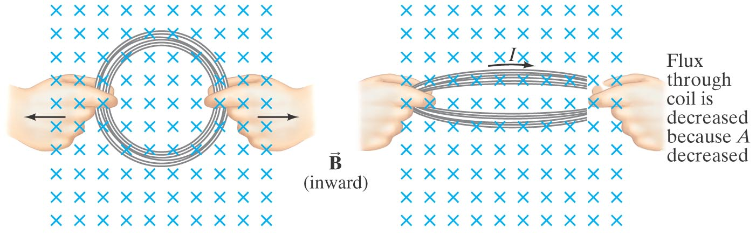
Faraday’s Law of Induction; Lenz’s Law
Magnetic flux will change if the area of the loop changes.
Notes:
Figure 29-6. A current can be induced by changing the area of the coil, even though B doesn’t change. Here the area is reduced by pulling on its sides: the flux through the coil is reduced as we go from (a) to (b). Here the brief induced current acts in the direction shown so as to try to maintain the original flux (Φ = BA) by producing its own magnetic field into the page. That is, as the area A decreases, the current acts to increase B in the original (inward) direction.

Slide 20
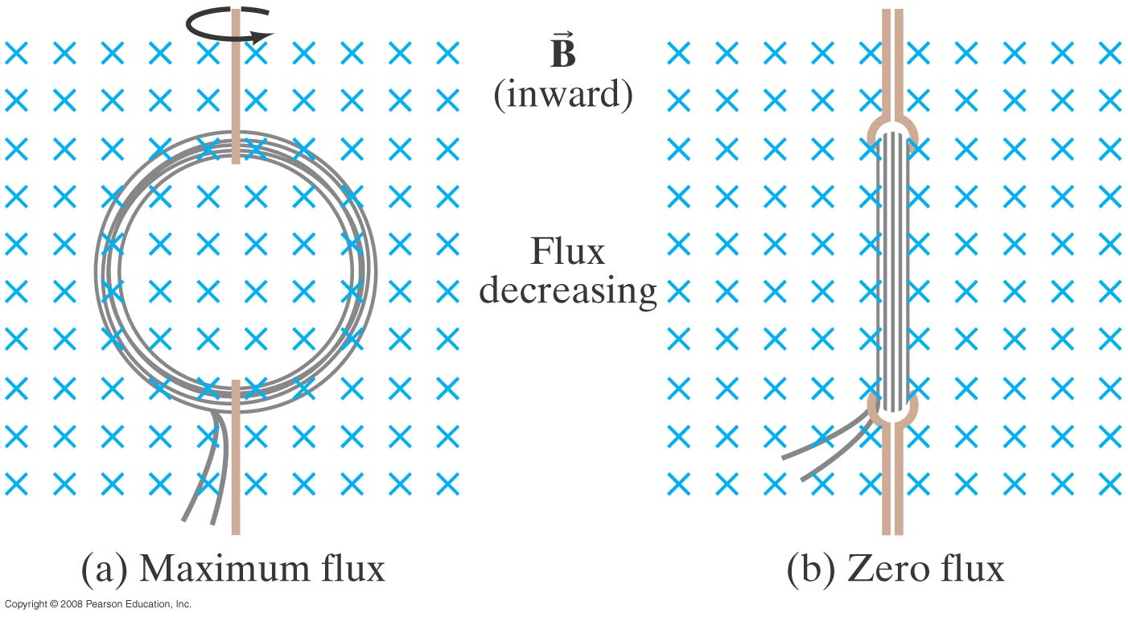
Faraday’s Law of Induction; Lenz’s Law
Magnetic flux will change if the angle between the loop and the field changes.
Notes:
Figure 29-7. A current can be induced by rotating a coil in a magnetic field. The flux through the coil changes from (a) to (b) because θ (in Eq. 29–1a, Φ = BA cos θ) went from 0° (cos θ = 1) to 90° (cos θ = 0).

Slide 21
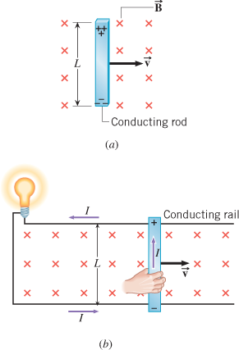
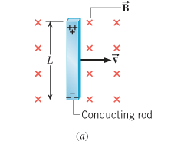
Motional Emf
The Emf Induced in a Moving Conductor

Slide 22
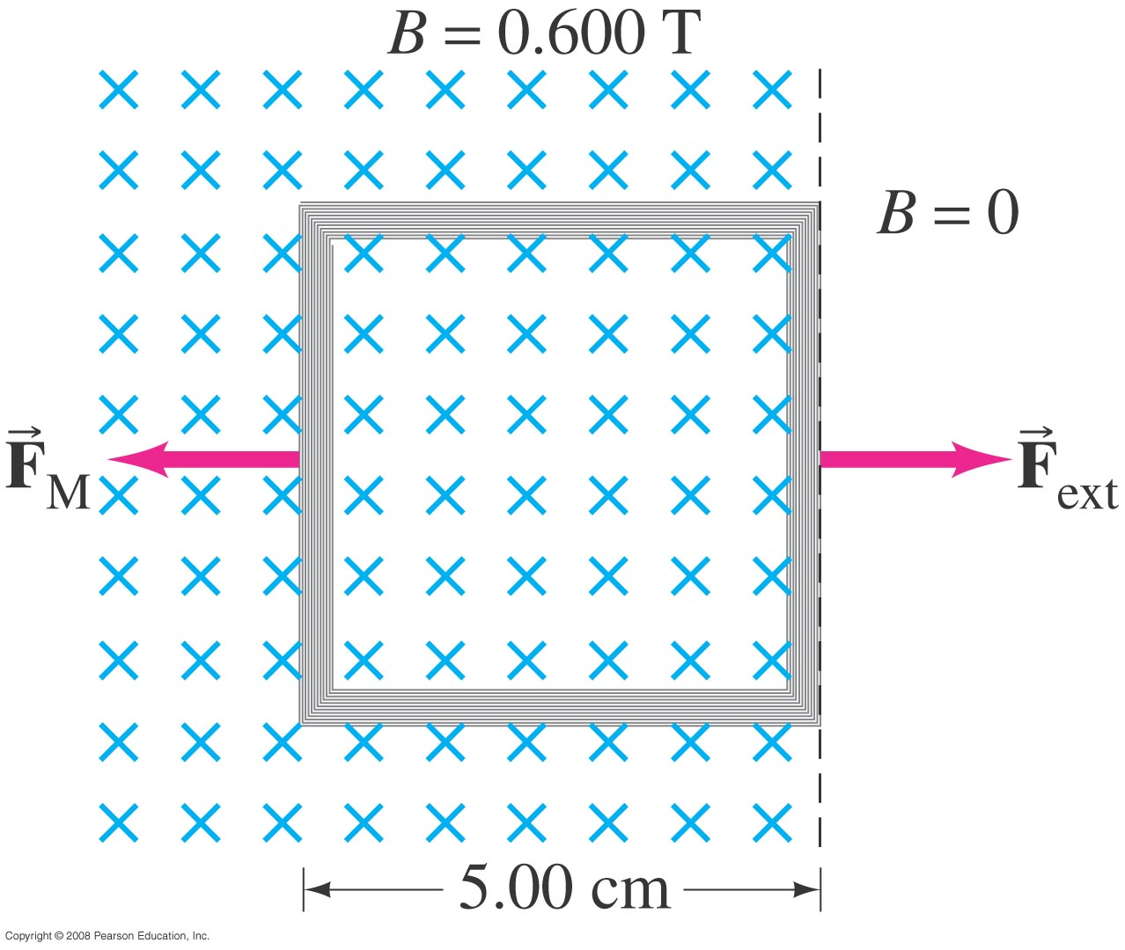
Faraday’s Law of Induction; Lenz’s Law
Example 29-5: Pulling a coil from a magnetic field.
A 100-loop square coil of wire, with side l = 5.00 cm and total resistance 100 Ω, is positioned perpendicular to a uniform 0.600-T magnetic field. It is quickly pulled from the field at constant speed (moving perpendicular to B) to a region where B drops abruptly to zero. At t = 0, the right edge of the coil is at the edge of the field. It takes 0.100 s for the whole coil to reach the field-free region. Find (a) the rate of change in flux through the coil, and (b) the emf and current induced. (c) How much energy is dissipated in the coil? (d) What was the average force required (F_{ext})?
Notes:
Solution: a. The flux goes from BA to zero in 0.100 s, so Δ Φ_{B}/Δ t = BA/t = -1.50 x 10⁻² Wb/s.
b. The emf is –N Δ Φ_{B}/Δ dt = 1.50 V. The current is emf/R = 15.0 mA.
c. E = Pt = I²Rt = 2.25 x 10⁻³ J.
d. F = W/d = 0.0450 N.

Slide 23
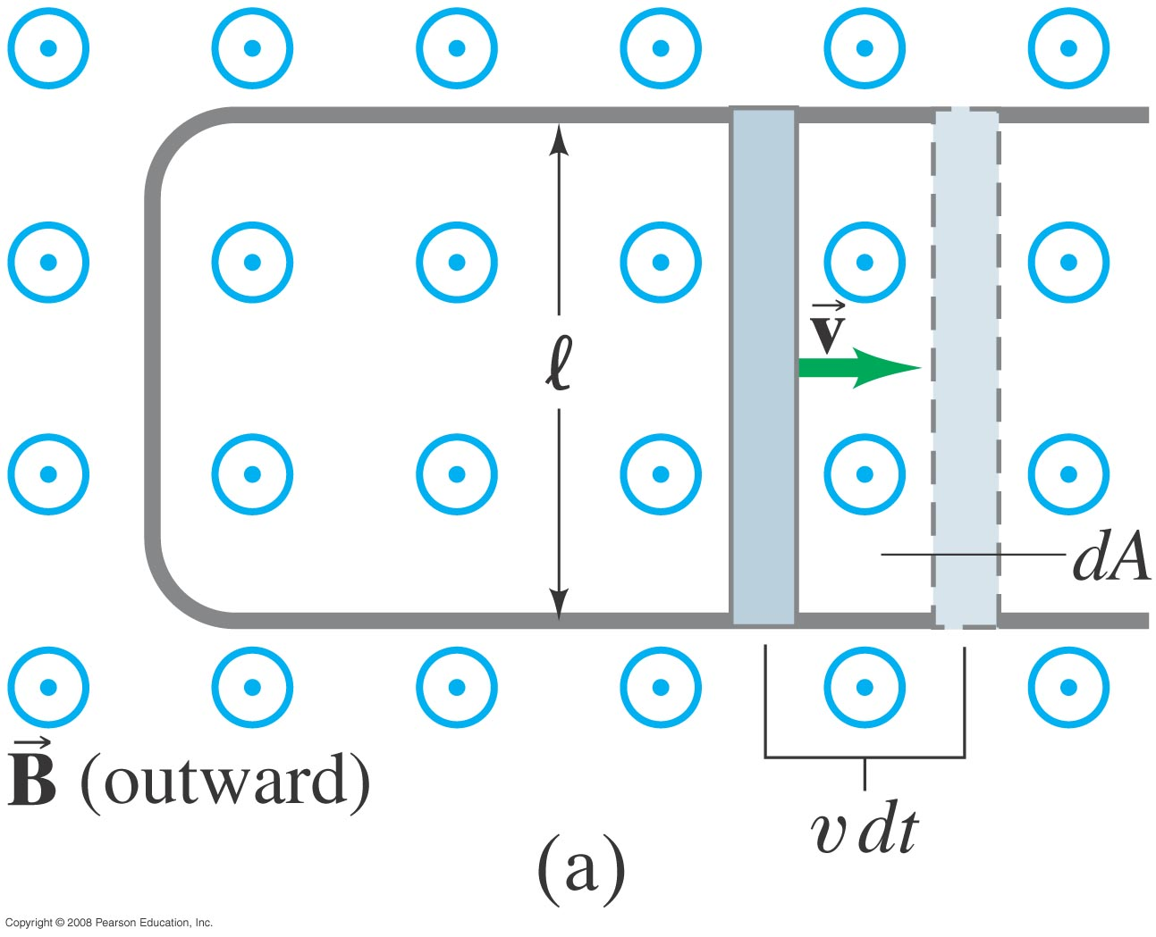
EMF Induced in a Moving Conductor
This image shows another way the magnetic flux can change:
Notes:
Figure 29-12a. A conducting rod is moved to the right on a U-shaped conductor in a uniform magnetic field B that points out of the page. The induced current is clockwise.

Slide 24
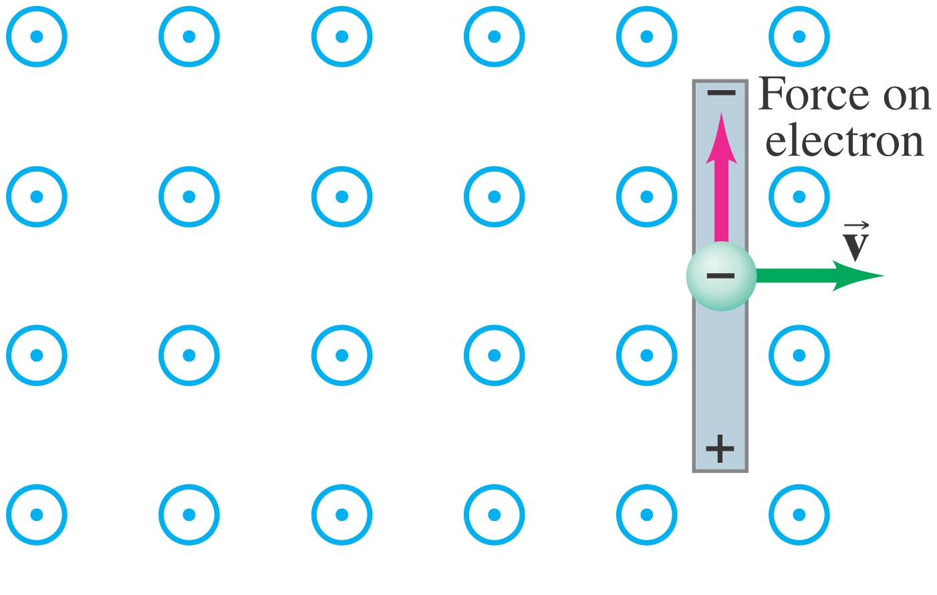
EMF Induced in a Moving Conductor
The induced current is in a direction that tends to slow the moving bar – it will take an external force to keep it moving.
Notes:
Figure 29-12b. Upward force on an electron in the metal rod (moving to the right) due to B pointing out of the page.

Slide 25
EMF Induced in a Moving Conductor
The induced emf has magnitude
This equation is valid as long as B, l, and v are mutually perpendicular (if not, it is true for their perpendicular components).

Slide 26
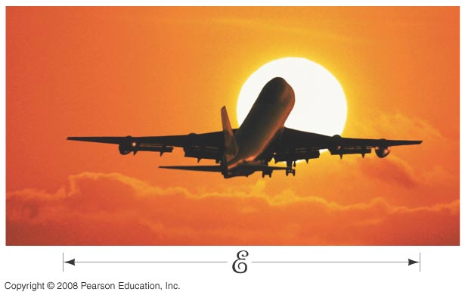
EMF Induced in a Moving Conductor
Example : Does a moving airplane develop a large emf?
An airplane travels 1000 km/h in a region where the Earth’s magnetic field is about 5 x 10⁻⁵ T and is nearly vertical. What is the potential difference induced between the wing tips that are 70 m apart?
Notes:
Solution: E = Blv = 1 V.

Slide 27

Example: An airplane travels 1000 km/h in a region where the earth’s field is 5x10⁻⁵ T and is vertical. What is the potential difference induced between the wing tips that are 70 m apart?
























v













Slide 28
The electrons “pile up” on the left hand wing of the plane, leaving an excess of + charge on the right hand wing.
The equation for ε at the bottom of slide 10 gives the potential difference. (You’d have to derive this on a test.)
-
























v












+
No danger to passengers! (But I would want my airplane designers to be aware of this.)

Slide 29
Example: Blood contains charged ions, so blood flow can be measured by applying a magnetic field and measuring the induced emf. If a blood vessel is 2 mm in diameter and a 0.08 T magnetic field causes an induced emf of 0.1 mv, what is the flow velocity of the blood?
ε = B ℓ v
v = ε / (B ℓ)
If B is applied ⊥ to the blood vessel, then B is ⊥ to v. The ions flow along the blood vessel, but the emf is induced across the blood vessel, so ℓ is the diameter of the blood vessel.
v = (0.1x10⁻³ V) / ( (0.08 T)(0.2x10⁻³ m) )
v = 0.63 m/s

Slide 34
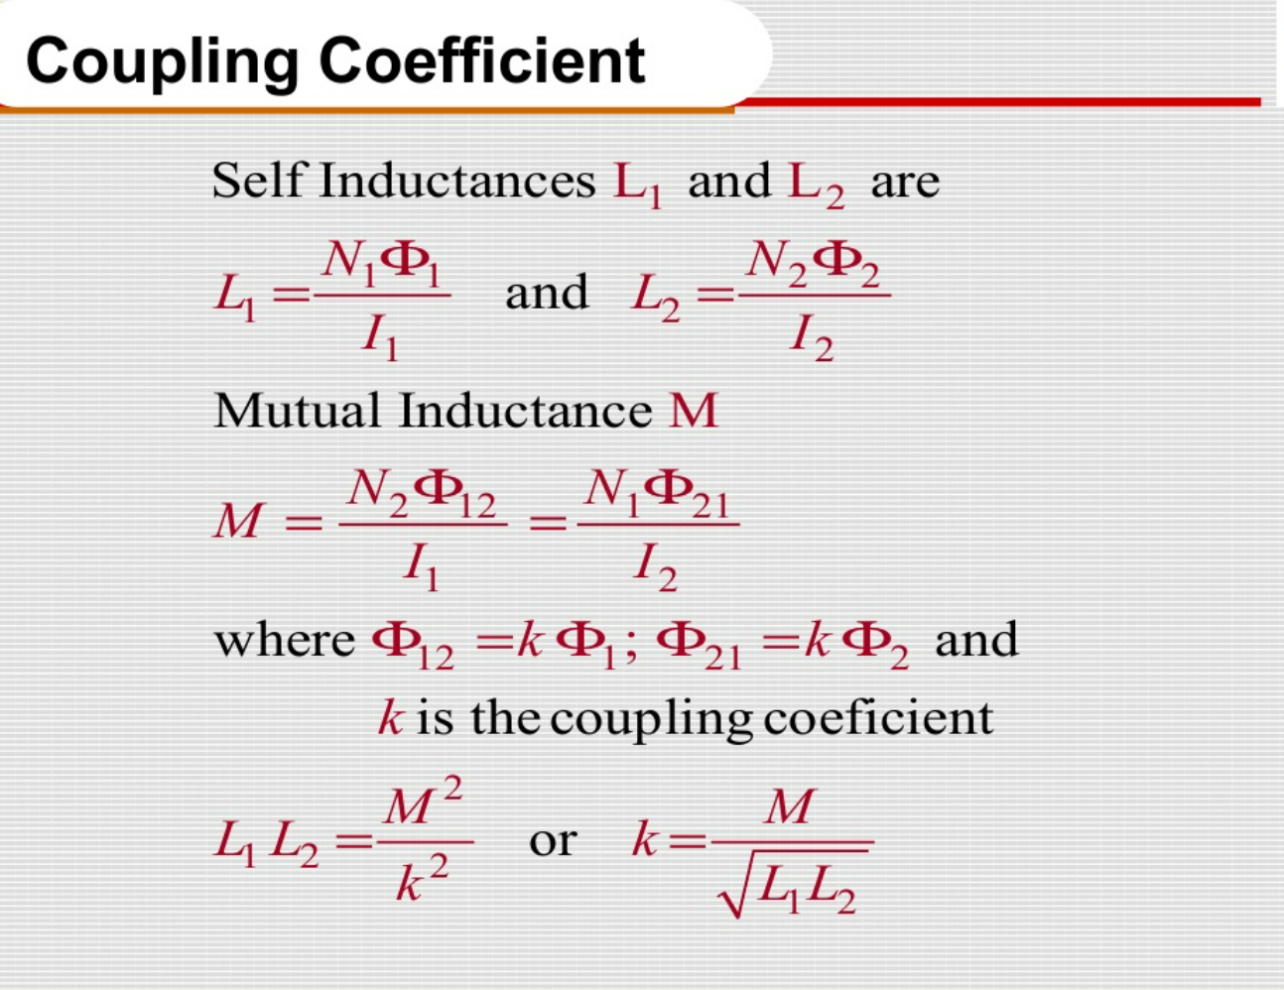

Slide 35

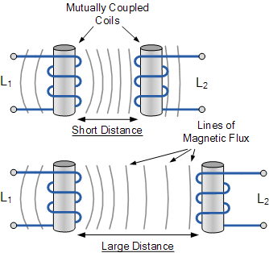

Slide 36



Slide 37


Slide 38

Coupling Factor Between Coils

Slide 39
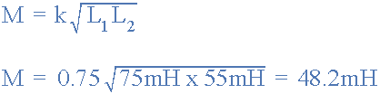
Mutual Inductance Example No1
Two inductors whose self-inductances are given as 75mH and 55mH respectively, are positioned next to each other on a common magnetic core so that 75% of the lines of flux from the first coil are cutting the second coil. Calculate the total mutual inductance that exists between the two coils.

Slide 40

Mutual Inductance Example No2
When two coils having inductances of 5H and 4H respectively were wound uniformly onto a non-magnetic core, it was found that their mutual inductance was 1.5H. Calculate the coupling coefficient that exists between.

Slide 41
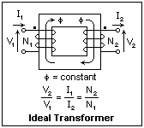
Ideal Transformer | Practical Transformer
It has 100% efficiency. | It has 100% below efficiency.
It has no losses. | It has no losses.
Purely inductive material is used. | It is two purely inductive material used.
It has no I²R losses. | It has I²R losses.
It has no iron loss. | It has iron loss.
There is no ohmic resistance drop. | There is ohmic resistance drop.
It has no leakage drop. | It has leakage drop.
In it ideal condition. | In it practical condition.
It is not used in practical condition. | It is used in practical condition.

